Slide 1
You can choose the world you want
FAIRTRADE FORTNIGHT
22 FEBRUARY – 8 MARCH 2021

Slide 2
This Fairtrade Fortnight we are thinking about what we want the world to be and the ways in which we can make choices to shape the world.

Slide 3
What is ‘a choice’? Having a choice means the right or possibility of choosing between different things. In your choices, you get to weigh up the good things and bad things about the options.

Slide 4
What choices have you made today? Maybe you chose what to have for breakfast. Toast, fruit or cereal, or maybe pancakes? Did you get a choice between your bike and your scooter to travel to school, if you are in school? Maybe you chose an extra ten minutes in bed rather than having a shower! To make good choices we need information about what our choices will mean for us, and what effect they will have on others.

Slide 5
Many of our choices will have an effect on other people.
Sometimes they will have a big effect.

Slide 6
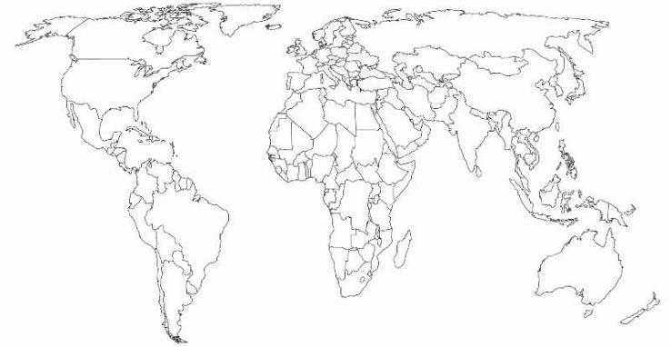
Where does it come from?
We are here!
Tropic of Cancer
Panama
Tropic of Capricorn
Kenya
Côte d'Ivoire

Slide 7
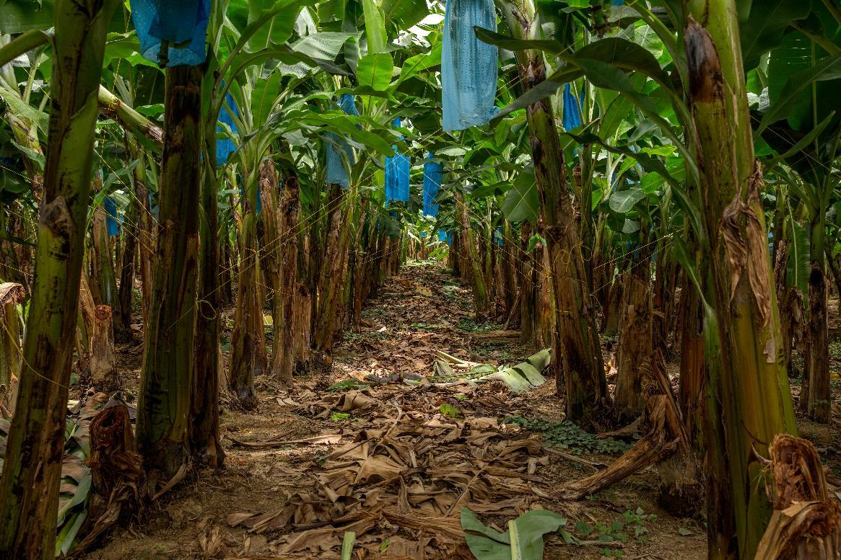
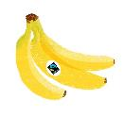
Where does it come from?
Bananas grow in tropical countries. Many bananas we buy come from Central America and the Caribbean.

Slide 8
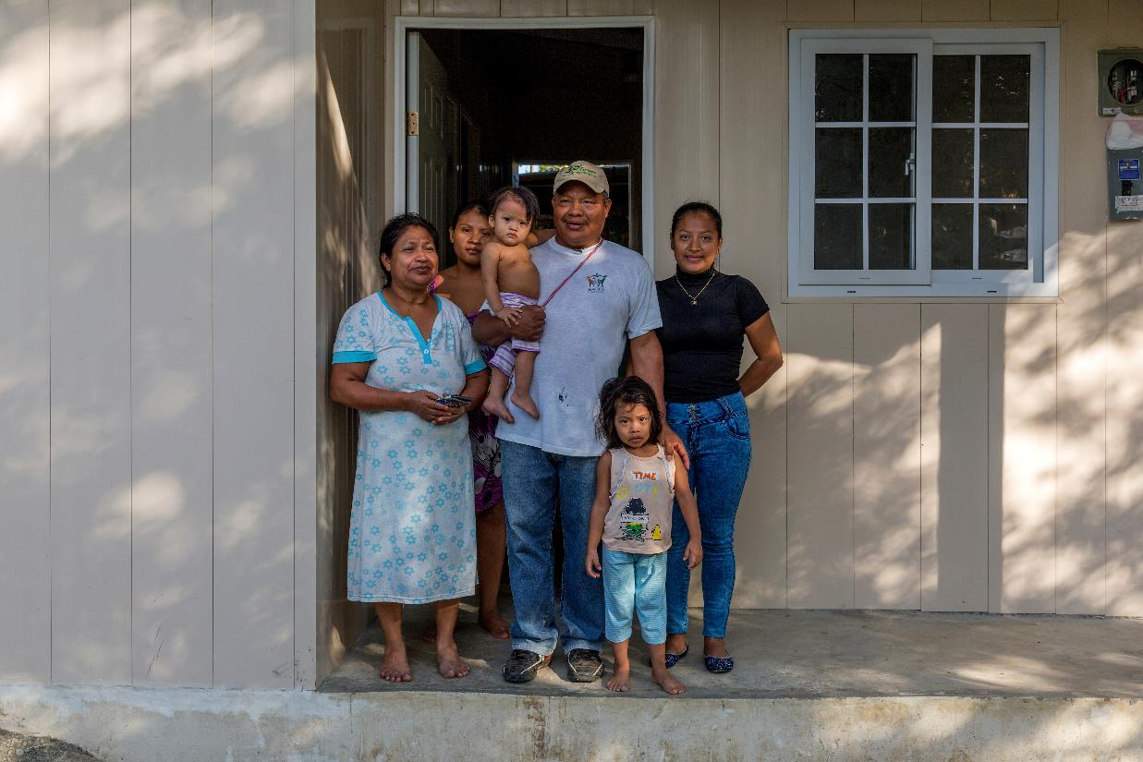
Where does it come from?
For example, from countries like Panama, where Marcial is a banana farmer. He grows his bananas, with the help of his family on a small plot of land, and relies on the money he makes selling his bananas to support his family. Sometimes this is very difficult.
Notes:
I think the title of this needs to be more about incomes – maybe something like 'the reality of farmer poverty' or similar.. I like the layout here.

Slide 9
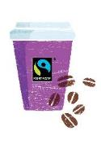
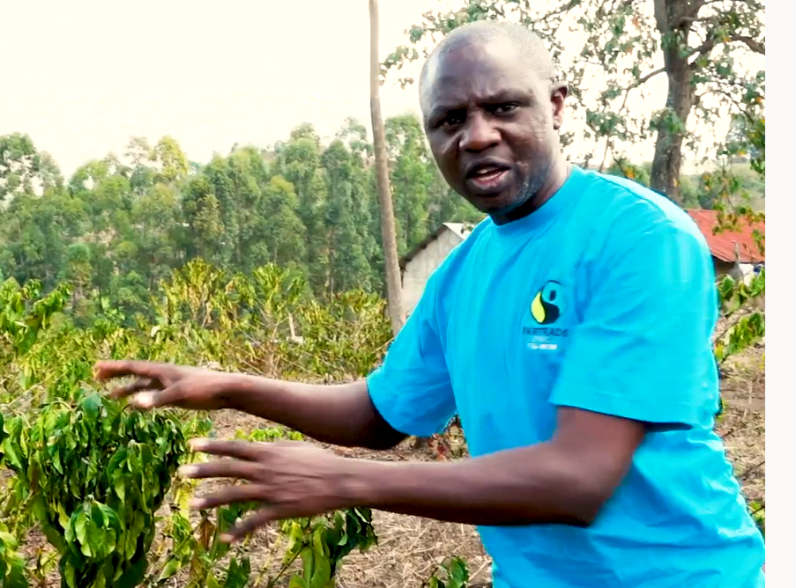
Where does it come from?
Coffee needs good warm temperatures to grow, and good rainfall to flower and grow the coffee cherries. If the rain comes at the wrong time, the coffee plants can become too dry and die. Farmers depend on making a good income from their coffee and rely on the weather being right. In Kenya, Bernard is a coffee farmer. He helps train other farms to find ways to protect their crops.

Slide 10
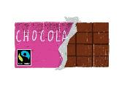
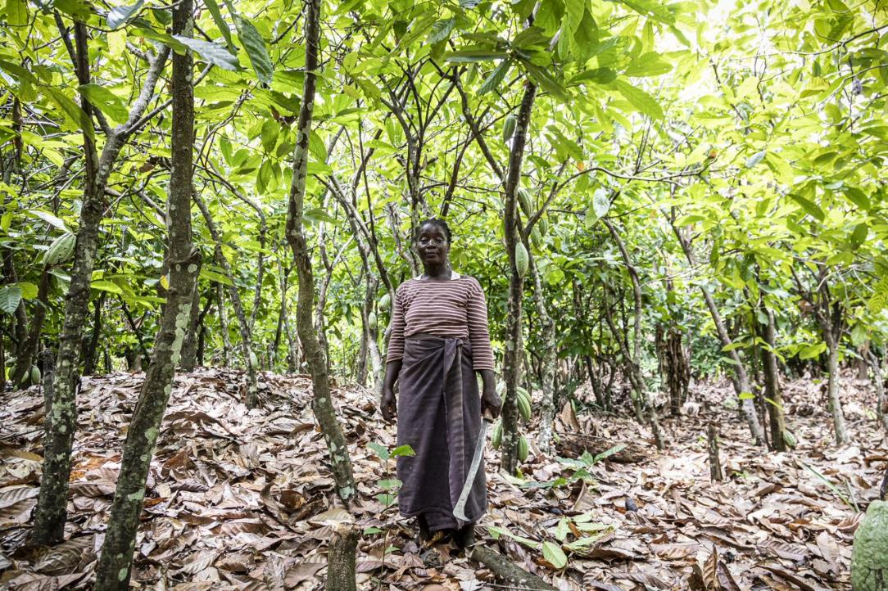
Where does it come from?
Cocoa only grows in tropical forests, where it is very warm and humid, and there is some protection from other types of trees. These cocoa farms are often remote, a long way from towns and cities, and farmers struggle to earn enough money to meet their needs. Farmers like Thérèse. Her village does not even have a road. You can only get to it by foot, motorbike or 4- wheel drive vehicle through the fields.

Slide 11
Your choices make a difference

Slide 12
Everything we eat, wear, play with has been grown or made by someone somewhere, and the products we buy will make a difference to the sort of life those people have. The more we learn about the people we rely upon, the more likely we are to want to make good choices.

Slide 13
To make a choose that is good for us, we need to know a bit about what our options are. But the choices we make don’t just affect us. Many of our choices will have an effect on other people. Sometimes they will have a big effect. Today, you have already made choices that impact the lives of many other people around the world. The things we buy and enjoy have a big effect on the lives of other people.

Slide 14
CHOOSE THE WORLD YOU WANT
Sharing our vision of the world we want for farmers and workers
Joining the Choose the World you want festival
Watching Change the world through your choices

