Slide 2
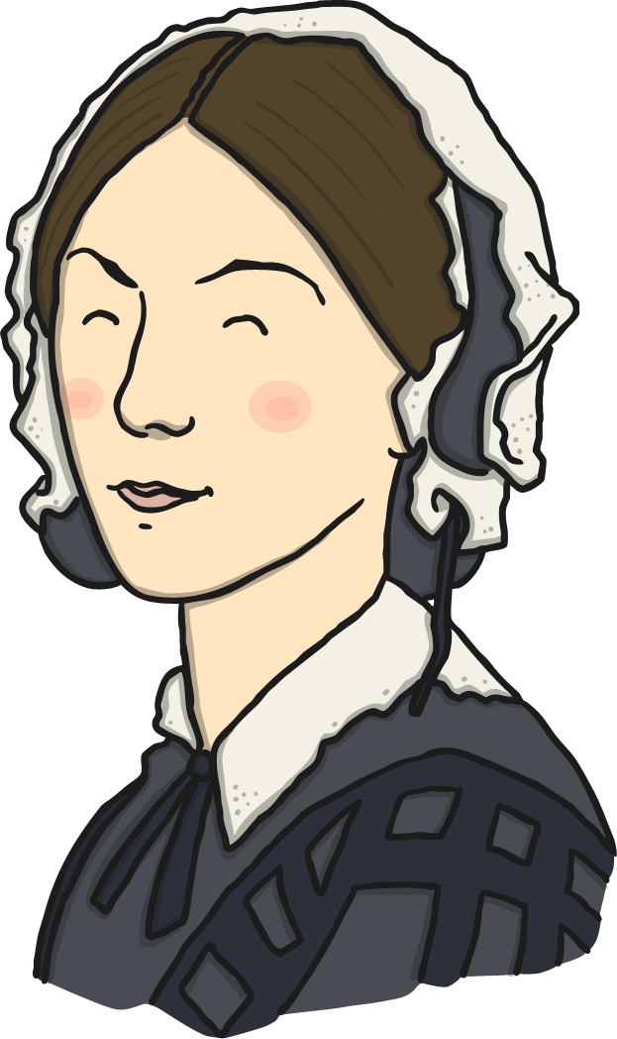
Who Was Florence Nightingale?
Florence Nightingale was born in 1820.
She was named Florence after Florence in Italy, where she was born.
She died in 1910.
She is still famous today.
She became a nurse and helped soldiers who were hurt in the war.

Slide 3
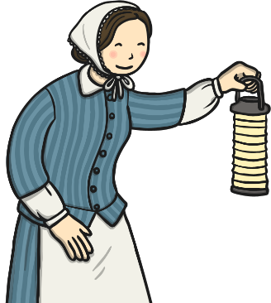
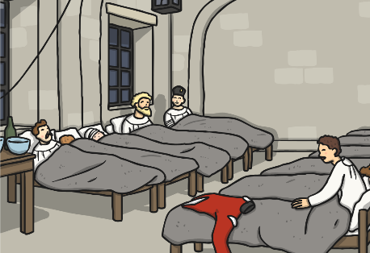
Who Was Florence Nightingale?
She is known as the ‘Lady of the Lamp’ because she carried a lamp with her when she checked on her patients in the night.
Make It!
Make your own Florence Nightingale lamp using this activity sheet

Slide 4
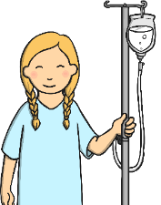
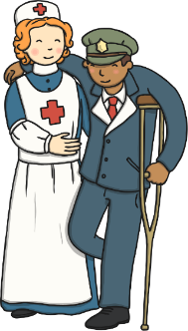
Why Is Florence Nightingale Remembered?
She changed the way that hospitals looked after their patients.
She changed the way that people thought about nurses.
She changed the way that people thought about women.

Slide 5
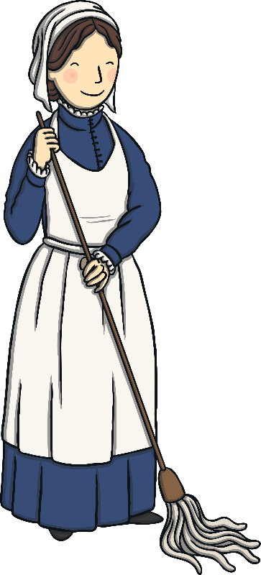
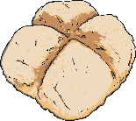
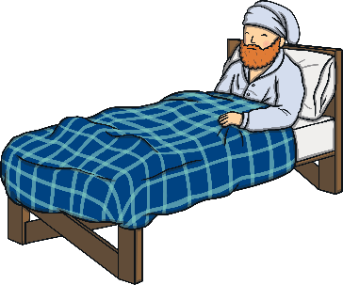
How Did Florence Nightingale Help?
She changed the way hospitals looked after their patients.
Before Florence Nightingale, hospitals were overcrowded and there were not enough beds. Hospitals were dirty and had rats and there weren’t enough doctors to help the patients.
Florence Nightingale made hospitals cleaner.
She gave patients good food.
She saved many lives.

Slide 6
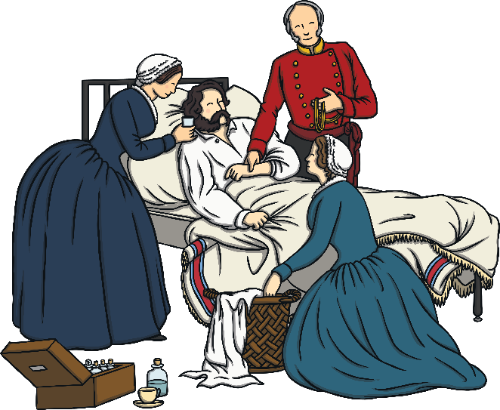
How Did Florence Nightingale Help?
She changed the way hospitals looked after their patients.
Florence Nightingale showed that trained nurses and clean hospitals could help sick people to get better.
Because of this, she is called the founder of modern nursing.
Make a role play hospital in your classroom. Is it hard work to look after all of the patients?
Try It!

Slide 7
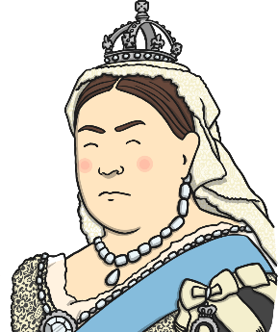
How Did Florence Nightingale Help?
She changed the way that people thought about nurses.
In the past, most people thought that only male doctors could look after patients and that nurses should only do the tidying and cleaning up.
In the past, nurses were not trained.
Florence Nightingale met Queen Victoria and told her what was wrong with army hospitals.

Slide 8
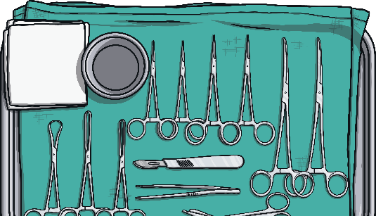
How Did Florence Nightingale Help?
She changed the way that people thought about nurses.
She opened a nursing school called the ‘Nightingale Training School for Nurses’.
Florence Nightingale wrote a book called Notes for Nursing.
Read It!
Read this poem about Florence Nightingale’s work in the Crimean War:

Slide 9
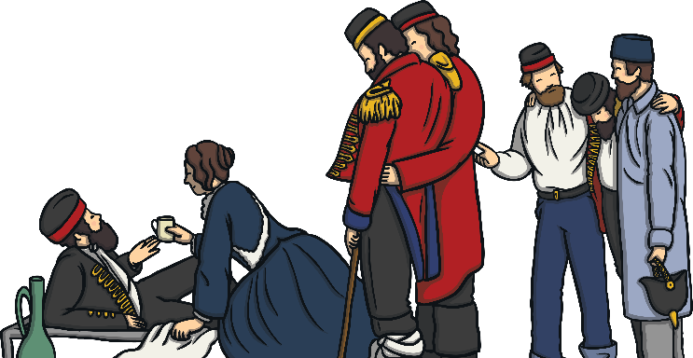
How Did Florence Nightingale Help?
She changed the way that people thought about women.
In the past, most rich women like Florence got married and looked after their homes instead of working.
Florence decided she wanted to work.
She showed that women could choose to work and do things outside the home.

Slide 10
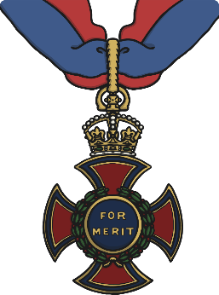
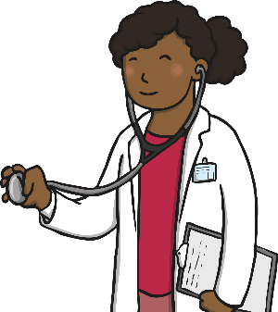
How Did Florence Nightingale Help?
She changed the way that people thought about women.
In 1907, Florence Nightingale was awarded the Order of the Merit by King Edward VII.
She was the first woman to receive this honour.
In the past, people thought that women could not do the same jobs as men. Do you think this is fair? Do people still think like this today?
Discuss It!

Slide 11
Do It!
Sort the statements into the table.
Before Florence Nightingale | After Florence Nightingale
There were rats in the hospitals.
Nurses were allowed to look after patients.
The patients were dirty.
Nurses were allowed to look after patients.
There were rats in the hospitals.
The patients were dirty.
There were not enough doctors.
Patients had fresh food.
There were not enough doctors.
Patients had fresh food.
Before
After
Before
After
Before
After
Before
After
Before
After
Before
After
Before
After
Before
After
Before
After
Before
After
The hospitals were cleaner.
The army started training doctors.
Patients had mouldy food.
The hospitals were cleaner.
The army started training doctors.
Patients had mouldy food.
Patients had clean clothes.
Patients had clean clothes.
After
Before
After
Before
After
Before
After
Before
After
Before
After
Before
Before
After
Before
After
Next Page

Slide 12
What Was Florence Nightingale Like?
She was determined – when she arrived in the Crimea, the doctors wanted nothing to do with her but Florence continued with her work.
She was kind – she wrote letters home for the injured men who could not write.
She was a good leader – she led a team of 38 nurses in the Crimean War.
Watch a video telling the story of Florence Nightingale's life and achievements.
Watch It!
What other words could you use to describe Florence Nightingale?
Discuss It!

Slide 13
Glossary
founder – a person who starts something
lamp – a kind of light
patient – someone who is unwell or injured and needs to be looked after
soldier – someone who serves in the army

